Slide 1
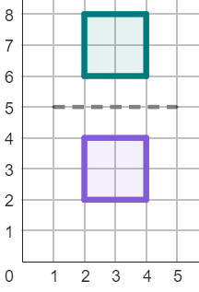
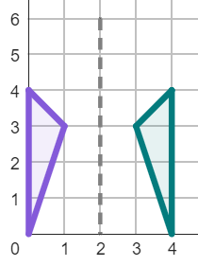

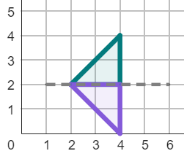
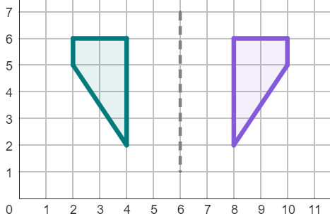
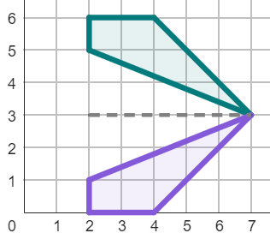
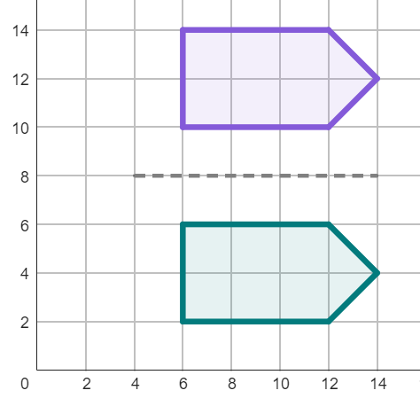
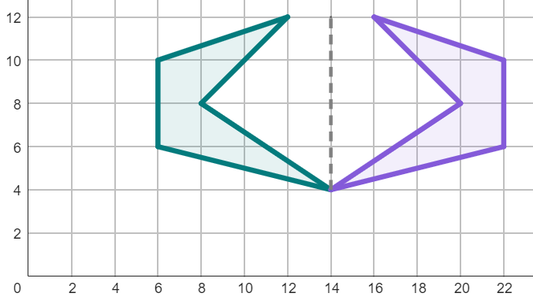
Describing a reflection
Task A: Describing a reflection with formal language
1) Match the descriptions to the reflections.
Description 1
Horizontal reflection
Line of reflection through the coordinates (2, 5) and (2, 0).
a
b
Description 2
Vertical reflection
Line of reflection through the coordinates (5, 2) and (0, 2).
Description 3
Vertical reflection
Line of reflection through the coordinates (2, 5) and (0, 5).
c
2) Complete the descriptions of these reflections.
Description 1
Description 2
reflection
Line of reflection through the
coordinates ( , 5) and ( , 1).
.
Line of reflection through the
coordinates ( , ) and ( , ).
3) Write full descriptions to these reflections.
Description 1
Description 2

Slide 2
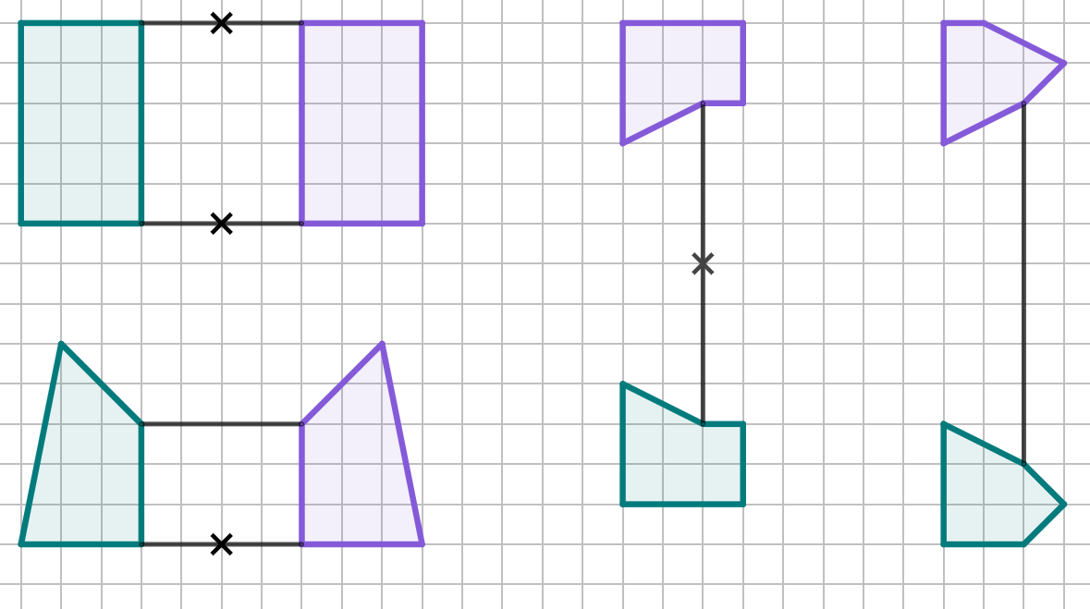
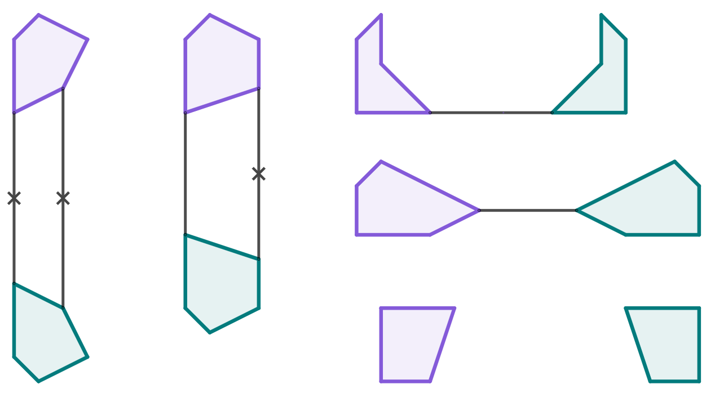
Describing a reflection
Task B: Applying strategies for finding the mirror line
1) Find the line of reflection for each of these partially completed diagrams.
2) Find the line of reflection for each of these partially completed diagrams. You will need to use a ruler.
v2.1

Slide 3
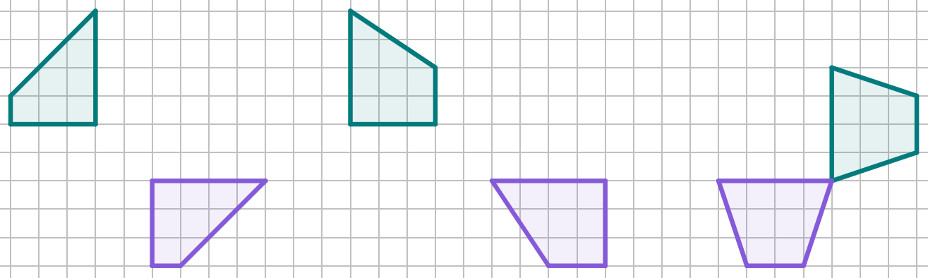
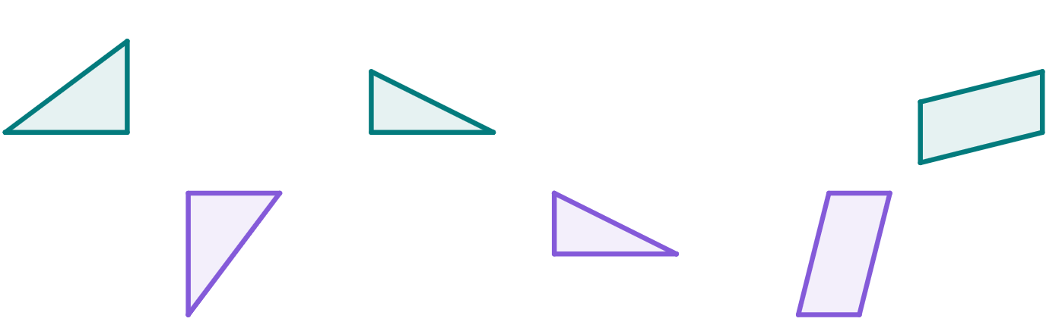
Describing a reflection
Task C: Diagonal reflections and non-reflections
1a) Which of these is a non-reflection? Draw line segments between corresponding points to find out!
b) Draw the line of reflection for all diagrams that show a reflection.
2a) Which of these is a non-reflection? Use a ruler to help you find out!
b) Draw the line of reflection for all diagrams that show a reflection.
Mathematics in Education and Industry

